Slide 2
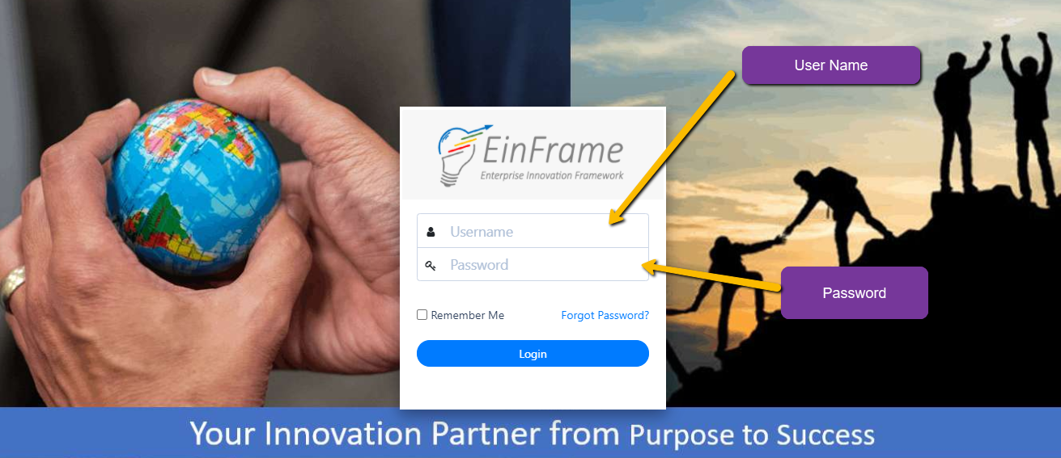
https://gil.einframe.com
Login Page

Slide 3
HOME PAGE INTRODUCTION

Slide 4
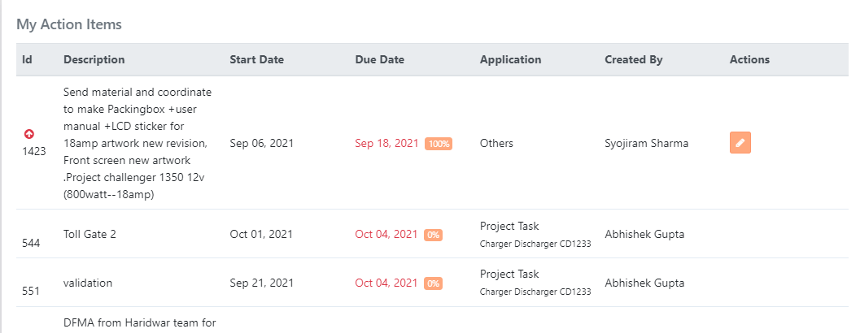
At home page at top My Action Items show, which means action item (From Project or Individual other than project tasks) assigned to you by either others or by yourself with date etc.
Assigned Action Items

Slide 5
Individual (other than project) tasks / action items percentage can be changed by you by clicking edit button in front of those action item after doing works on that. This illustrate to you or assignee that you are working on that task. This percentage is other than the timesheet process, you have to fill timesheets for that task separately.
Assigned Action Items
Edit Option

Slide 6
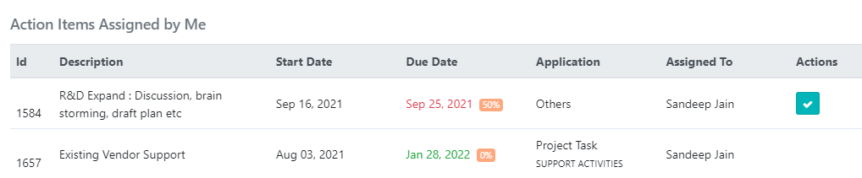
At home page at bottom Action Items Assigned by Me show, which means action item (From Project or Individual other than project tasks) assigned by you to others. You can monitor status of assigned action items from here, and after complete you can tick mark to mark done option showing in front of action item (Only for Individual action item).
Assigned Action Items
Mark Done Option

Slide 7
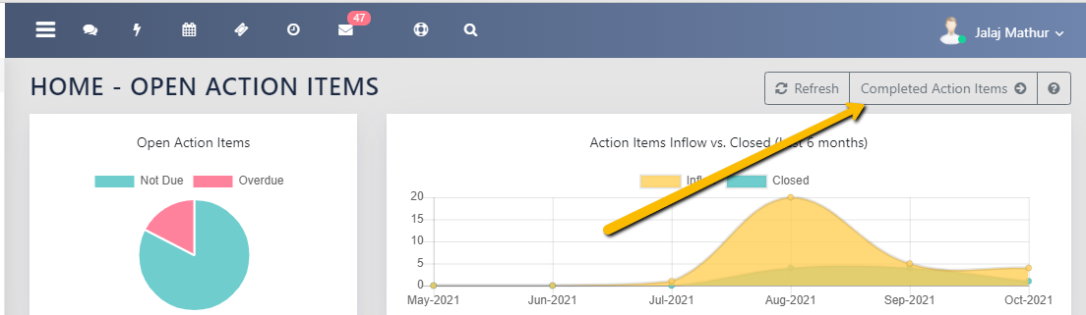
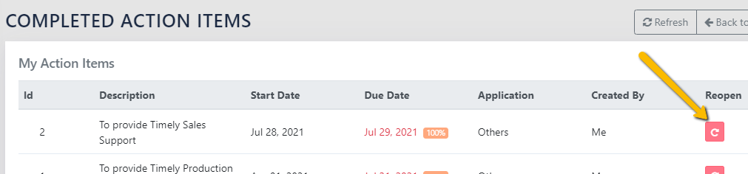
The closed (Completed) individual action items can see by click on Completed Action items Tab on right top of Home page.
Assigned Action Items
And can reopen the any individual action item by clicking Reopen logo of that action item if required.

Slide 8
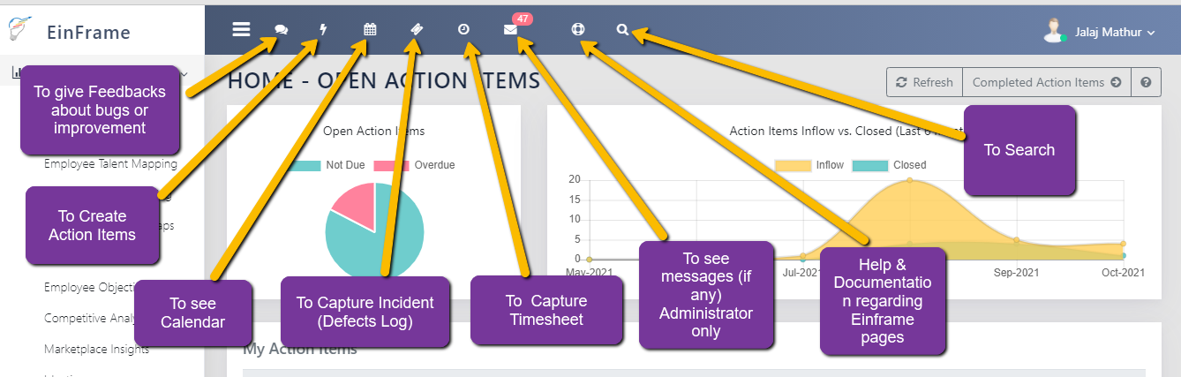
Shortcuts at Home Page

Slide 9
TIME SHEET FILLING

Slide 10

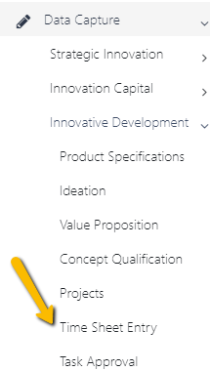
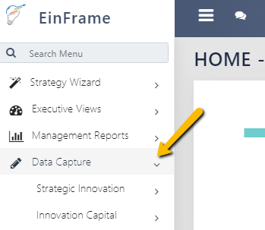
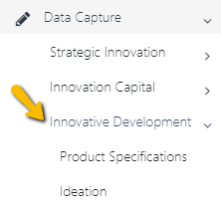
There are two ways to reach timesheet capture page.
Capture Timesheet
Option 1 : Via Home page shortcut as shown here.
Option 2 :
Step 1 : On side bar click on Data Capture
Step 2 : Then click on Innovative Development
Step 3 : Then Click on Timesheet Entry

Slide 11
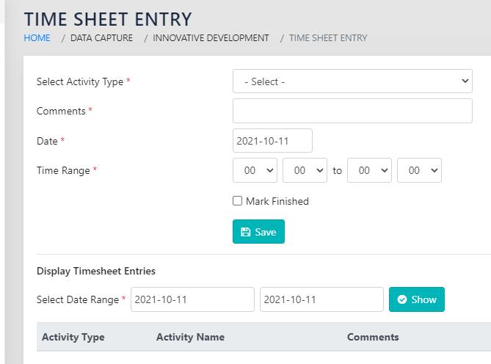
Capture Timesheet
By doing both ways you will reach Time sheet Entry page as below
→ Then first select date for which you need to fill time sheet.
→ Then select time range.

Slide 12
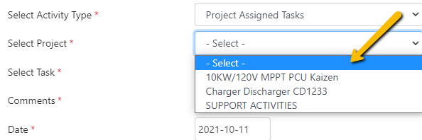
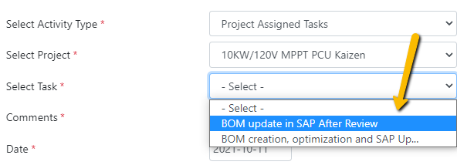
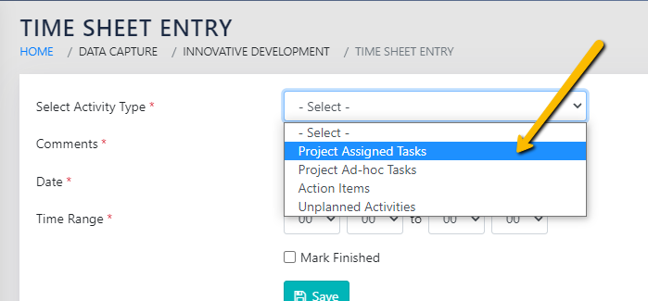
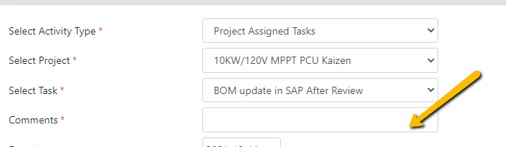
Capture Timesheet
For Project Related Timesheet :
→ First select Project Assigned task in Select Activity type
→ Then select Project.
→ Then select task
→ And then mentioned comments what you done and then save.

Slide 13
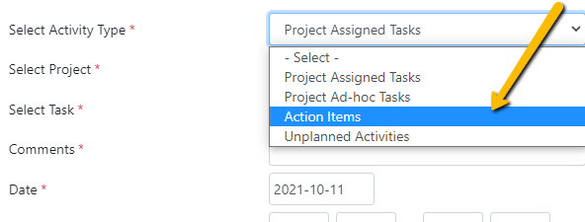
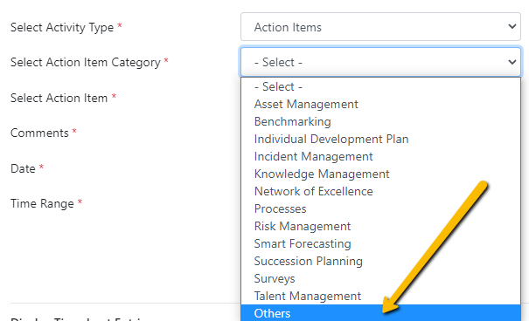
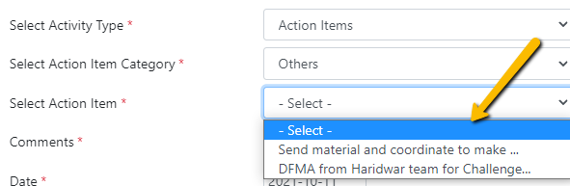
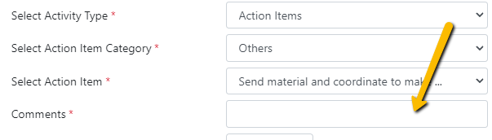
Capture Timesheet
For Individual Action Item (Other Than Project Related) Timesheet :
→ First select Action Items in Select Activity type
→ Then select Others in Action Item Category.
→ Then select task
→ And then mentioned comments what you done and then save.

Slide 14
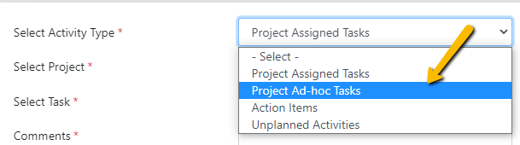
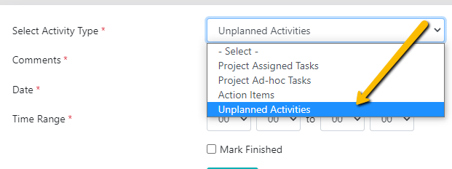
Capture Timesheet
There are another options like Project ad hoc tasks and Unplanned activities also there to fill timesheet if required.

Slide 15
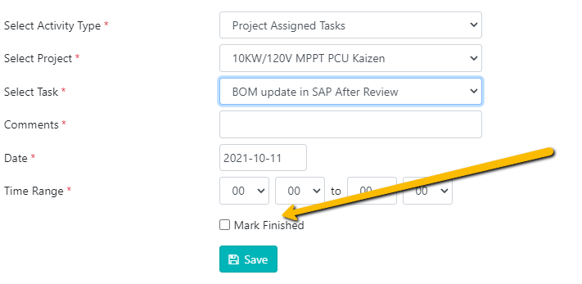
Capture Timesheet
Just above save button there is also option of Mark finished tick mark, this must tick only then when that particular tasks all done / completed from your side. Tick mark on this option shows you completed the tasks and no further work and not timesheet fill required on that task.
So If your task not done at time of timesheet fill, please do not tick on this.

Slide 16
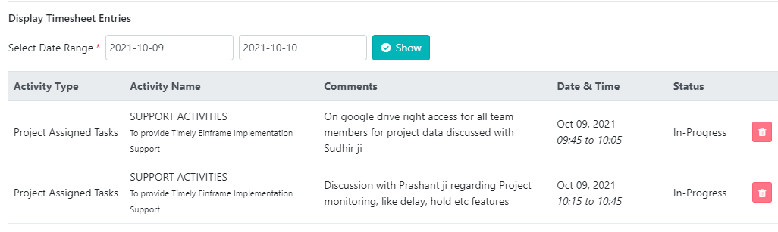
Display Captured Timesheet
On same page just below time sheet capture options there is one more option i.e. Display Timesheet Entries, you can see your own captured time sheet entries by selecting dates range here.

Slide 17
ASSIGN ACTION ITEM

Slide 18
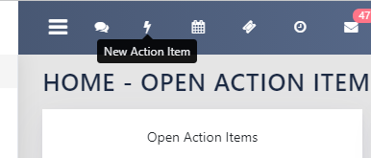
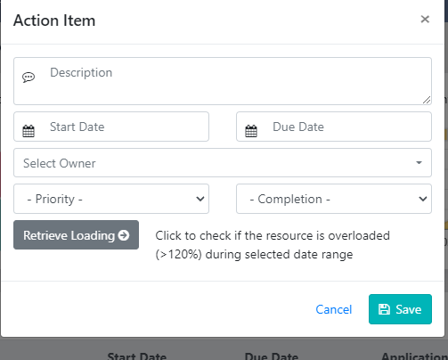
Create Action Item
1. Click on Home page shortcut “ New Action Item”
2. New pop up window to create action item opens.
3. In description mention the details of action item in such a way that assignee can understand the work.
4. Fill start date and due date of this action item.
5. Select owner means, whom to assign the task, write first three letter then system shows related user names, select the required one.
5. Mention the priority of this task.
6. Mention the completion percentage of this task, at time of assign.
7. For selected user you can retrieve (check) the loading on those dates.
8. Then save.

Slide 19
PROJECT CREATION

Slide 20
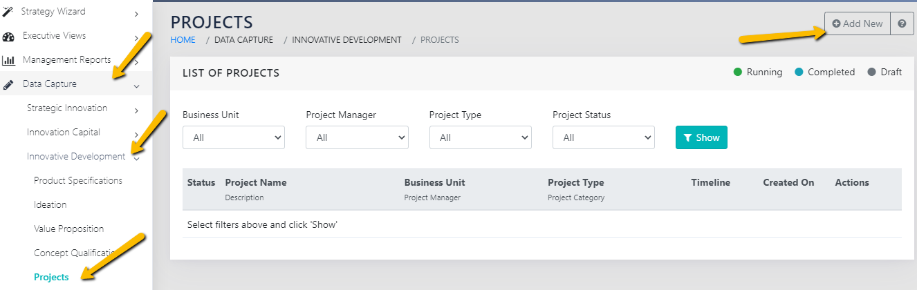
Create Project
Click on Data Capture tab on side bar.
Then under heading of data capture click on Innovative Development tab.
And then under that click on Projects.
Then right side projects screen shows as below.
To create new project click on right most tab “Add New”, then fill data, make team and add task and their planning.

Slide 21
PROJECT TASKS APPROVAL

Slide 22
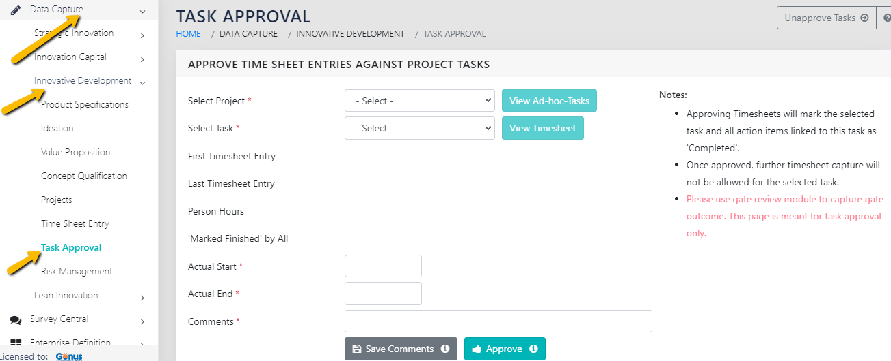
Project Task Approval
Click on Data Capture tab on side bar.
Then under heading of data capture click on Innovative Development tab.
And then under that click on Task Approval.
Then right side screen shows as below.

Slide 23
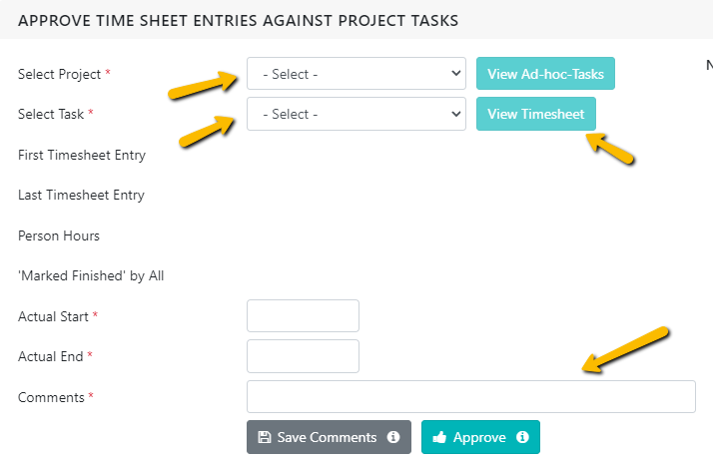
Project Task Approval
Select Project.
Then select Task.
By clicking “View Timesheet”, you can see all corresponding timesheet of that task.
You can mention comments and save, by clicking “Save Comments” without approve task, if you think work not completed.
The user can see this comment on Project Task report page at below that task.
If all OK then click on Approve button to approve task.

Slide 24
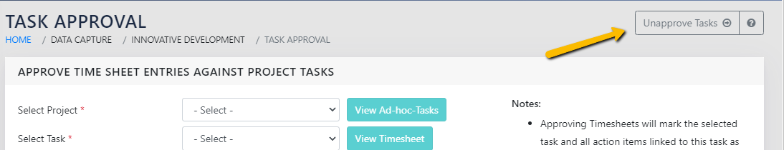
Project Task Approval
By click “unapprove task” see previously approved tasks and unapproved If required.

Slide 25
RISK MANAGEMENT

Slide 26
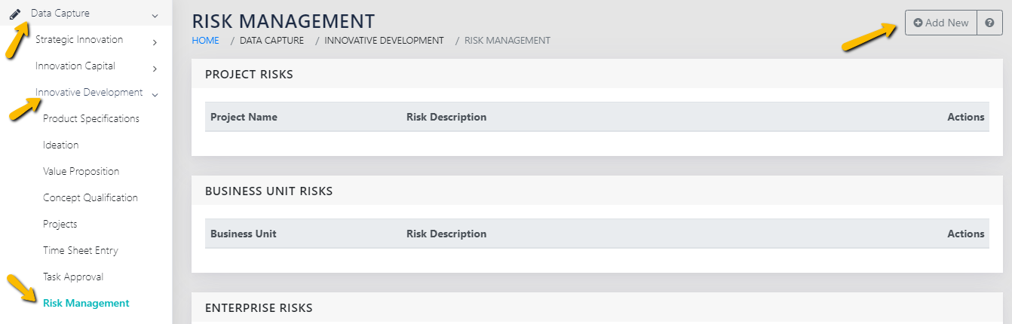
Risk Addition
Click on Data Capture tab on side bar.
Then under heading of data capture click on Innovative Development tab.
And then under that click on Risk Management.
Then right side screen shows as below.
To create new risk click on right most tab “Add New”.

Slide 27
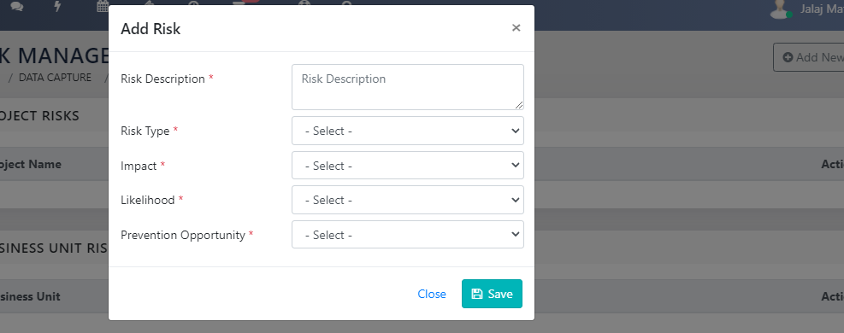
Risk Addition
Then separate pop up window opens, to create risk.
Fill data accordingly.

Slide 28
INCIDENT MANAGEMENT

Slide 29
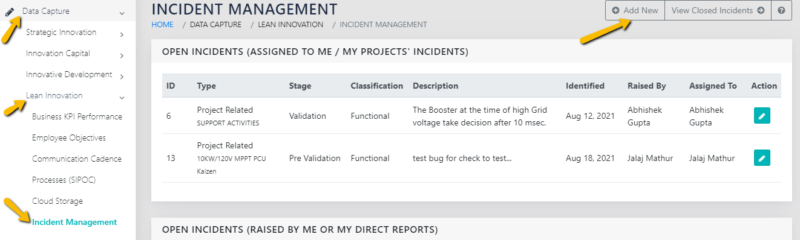
Incident Addition / Maintain
Click on Data Capture tab on side bar.
Then under heading of data capture click on Lean Innovation tab.
And then under that click on Incident Management.
Then right side screen shows as below.
To create new incident click on right most tab “Add New”.

Slide 30
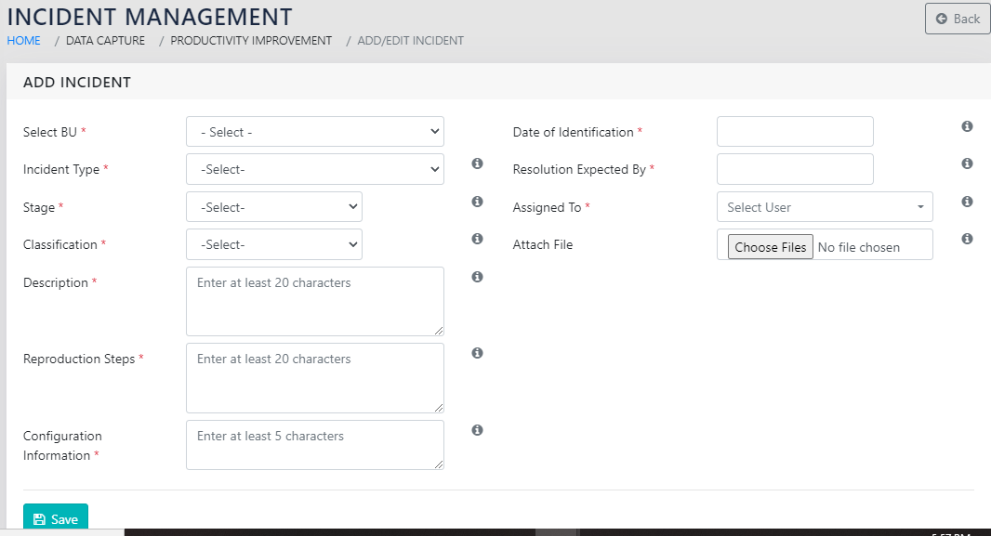
Incident Addition / Maintain
Then such type windows shows, fill data accordingly

Slide 31
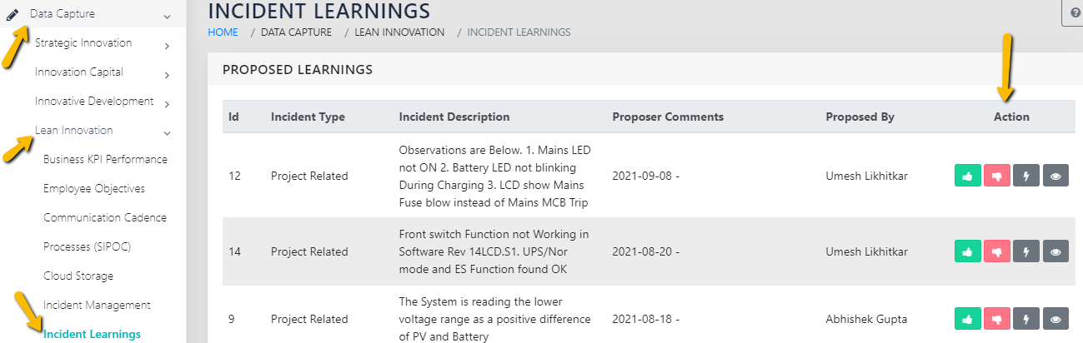
Incident Learning Management
Click on Data Capture tab on side bar.
Then under heading of data capture click on Lean Innovation tab.
And then under that click on Incident Learnings.
Then right side screen shows as below.
Correspondingly take action “Approve” or “Reject” or “Action Item” or “View” in Action heading tabs.

Slide 32
MANAGEMENT REPORTS

Slide 33
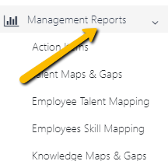
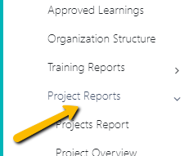
Project Related Reports
Click on “Management Report” from Side bar.
Then at last click on “Project Reports”.
Now below that all type of reports name showing.

Slide 34
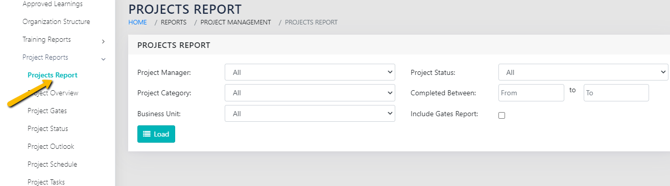
Project Reports
Click on “Project Report” below Project Reports from Side bar.
Then at right side of window the Project report screen shows as below.
You can load reports by many ways like Project manager, Project category, Project status, completed between and also can tick includes gates report.

Slide 35
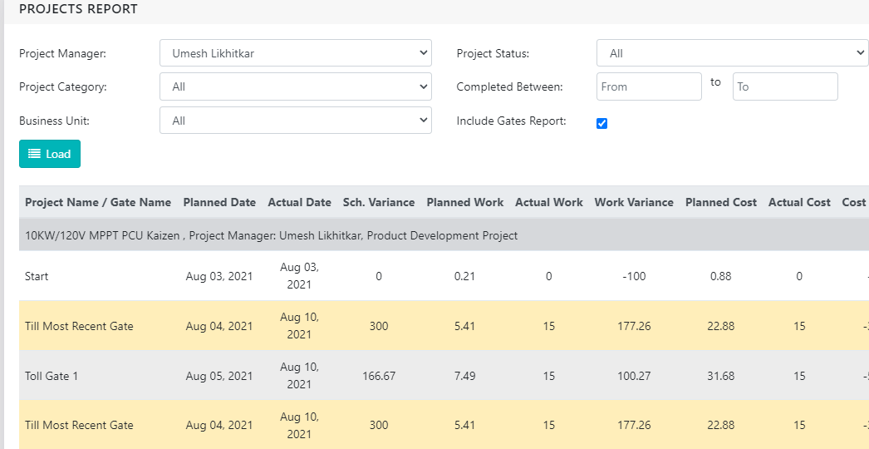
Project Reports
The Such type of report then shows including schedule variance, Work (effort) variance and Cost Variance etc.

Slide 36
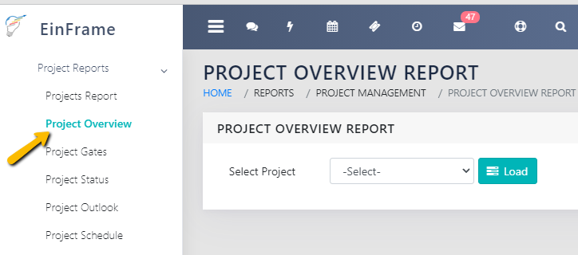
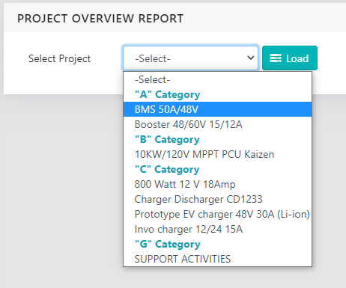
Project Overview Reports
To see next report Click on “Project Overview” below Project Report from Side bar.
Then at right side of window the Project overview report screen shows as below.
You can load reports by selecting project here.

Slide 37
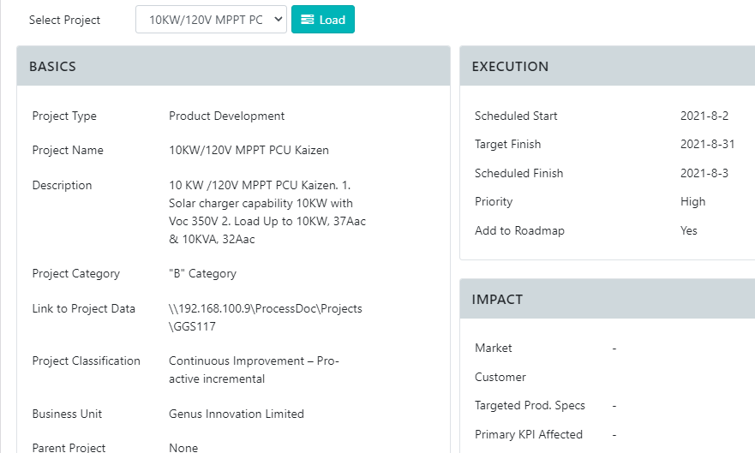
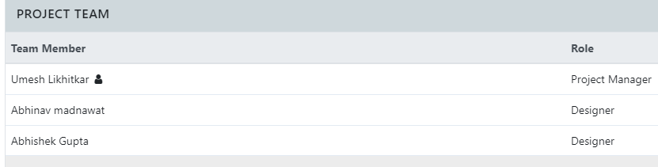
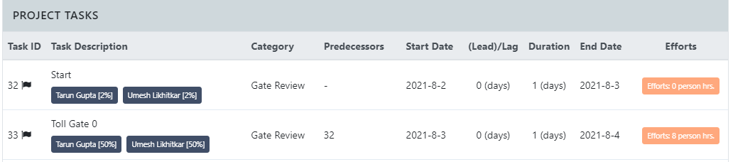
Project Overview Reports
The Such type of report then shows including information about project like type, name, description, category, project team, Project planned tasks, asset required, knowledge / training required, technology required, Risk (if filled in project page by project manager).

Slide 38
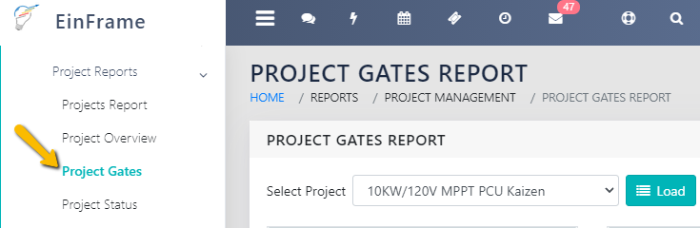
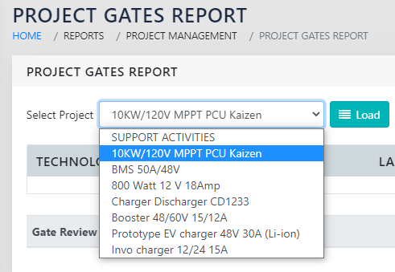
Project Gates Reports
To see next report Click on “Project Gates” below Project Report from Side bar.
Then at right side of window the Project Gates report screen shows as below.
You can load reports by selecting project here.

Slide 39
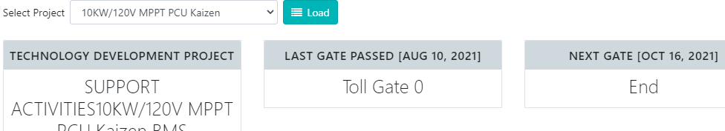
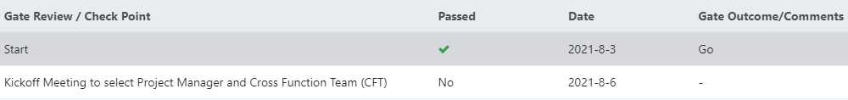
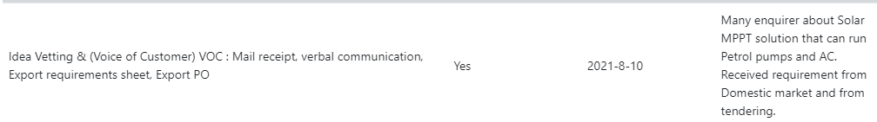
Project Gates Reports
The Such type of report then shows Toll Gates status, Filled check points and remarks during Gate review & approval.

Slide 40
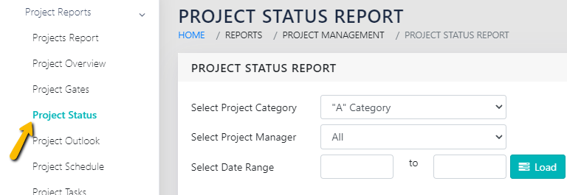
Project Status Reports
To see next report Click on “Project Status” below Project Report from Side bar.
Then at right side of window the Project Status report screen shows as below.
You can load reports by selecting project category, project manger and date range (for status) here.

Slide 41
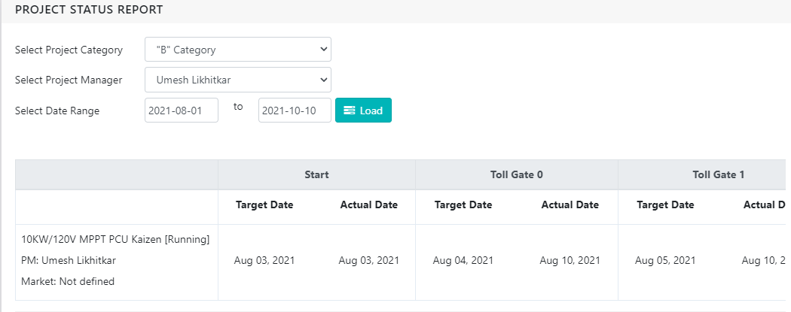
Project Status Reports
The Such type of report then shows target and actual dates of Toll Gates of projects.

Slide 42
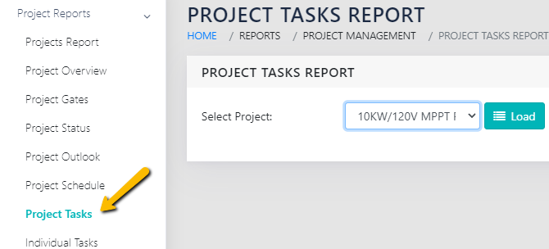
Project Task Reports
To see next report Click on “Project Task” below Project Report from Side bar.
Then at right side of window the Project Task report screen shows as below.
You can load reports by selecting project here.

Slide 43

Project Task Reports
The Such type of report then shows status of each task of that project, latest comments on each task (from task approval page).

Slide 44

Individual Task Reports
To see next report Click on “Individual Task” below Project Report from Side bar.
Then at right side of window the Individual Task report screen shows as below.
You can load reports by selecting User name and date range here.
Then click on download, the separate excel file will download as per selection.

Slide 45

Individual Task Reports
The Such type of report then shows in below formats as separate excel file.
Assigned activity name means assigned tasks.
That activity type means project related or others (individual action item).
If related to project, then project name.
Project manager name.
Planned start and planned end date of that activity / action item.
Actual start and actual end date of that activity / action item.

Slide 46

Tasks Planned VS. Actual Reports
To see next report Click on “Actual vs. Planned Tasks” below Project Report from Side bar.
Then at right side of window the report screen shows as below.
You can load reports by selecting User name and date range here (maximum allowed date range is 31 days here).
Then click on download, the separate excel file will download as per selection.

Slide 47

Tasks Planned VS. Actual Reports
The Such type of report then shows in below formats as separate excel file.
It arranged date wise.
Planned activity type means project related or others (individual action item).
If related to project, then project name, Assigned by.
Assigned activity name means assigned tasks.
Then Actually done activity type, corresponding project name (if any), assigned by, activity name and what done / filled in timesheet as Activity description.

Slide 48

Resource Loading Reports
To see next report Click on “Resource Loading” below Project Report from Side bar.
Then at right side of window the report screen shows as below.
You can load reports by selecting Quarter, User name
Then click on load.

Slide 49

Resource Loading Reports
The Such type of report then shows loading percentage date wise.

Slide 50

EVMS Chart Reports
To see next report Click on “EVMS Chart” below Project Report from Side bar.
Then at right side of window the report screen shows as below.
You can load reports by selecting Project name.
Then click on load.

Slide 51

EVMS Chart Reports
The Such type of report then shows EVMS (Planned Value, Earned Value and Actual Cost) in graph form.

Slide 52


Timesheet Reports
To see next report Click on “Timesheet Report” below Project Report from Side bar.
Then at right side of window the report screen shows as below.
Timesheet entries can filter by only for projects or all (include individual action items / unplanned also)
Select date range, user (or leave blank for all), then download, the separate excel file will download.

Slide 53

Incident Management Reports
To see Incidents (defects) report Click on “Incident Management” under Management Reports, above the Project Reports.
Then at right side of window the report screen shows as below.
Search according to filters given here and then load.

Slide 54

Incident Management Reports
The Such type of report then shows.
It can export to excel also.

Slide 55

Approved Learnings Reports
To see Approved learning report Click on “Approved Learnings” under Management Reports, above the Project Reports.
Then at right side of window the report screen shows as below.
All approved learning's (from Incident management) shows here.

Slide 56
Thank You

